Slide 1
Office Add-In 开发入门
R & D
Django 2020-04-22

Slide 2
主要内容
搭建网页项目框架
搭建Office组件框架
配置项目
启动项目
读取信息
写入信息
未来展望

Slide 3
搭建网页框架（VUE）
确保开发环境必要组件已经安装
创建VUE项目
选择手动模式搭建
选择Bable、Router、CSS预处理和Linter
ESLinter选择标准模式
使用独立的bable配置文件
等待安装……
VSCode打开项目，确保各项配置已经生效
cnpm i –G @vue/cli eslint
ESLint：打开main和App.vue查看是否可以自动格式化；安装ESLint插件，启动保存即格式化功能

Slide 4
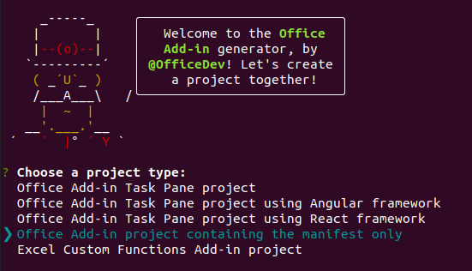
创建Office组件
确保开发环境必要组件已经安装
创建一个专门用于启动的目录 office-add-in
在目录的终端中安装office框架
选择Office Add-in Task Pane project
选择JavaScript
输入项目名称：Leo Assistant
选择Powerpoint
cnpm i –g yo generator-office
yo office
npx office-addin-dev-certs install

Slide 5
配置
var fs = require("fs");
var path = require("path");
var homedir = require('os').homedir()
module.exports = {
devServer: {
port: 3000,
https: true,
key: fs.readFileSync(path.resolve(`${homedir}/.office-addin-dev-certs/localhost.key`)),
cert: fs.readFileSync(path.resolve(`${homedir}/.office-addin-dev-certs/localhost.crt`)),
ca: fs.readFileSync(path.resolve(`${homedir}/.office-addin-dev-certs/ca.crt`))
}
}
安装证书
因为Office组件的开发，必须是带有CA证书，所以必须使用office工具生成一个证书，并且安装
配置VUE的启动端口和证书目录
引入office js
修改VUE启动文件main.js
修改manifest.xml文件的SourceLocation节点
<script src="https://appsforoffice.microsoft.com/lib/1/hosted/office.js"></script>
window.Office.initialize = () => {
new Vue({
router,
render: h => h(App)
}).$mount('#app')
}
<DefaultSettings>
<SourceLocation DefaultValue="https://localhost:3000/"/>
</DefaultSettings>

Slide 6
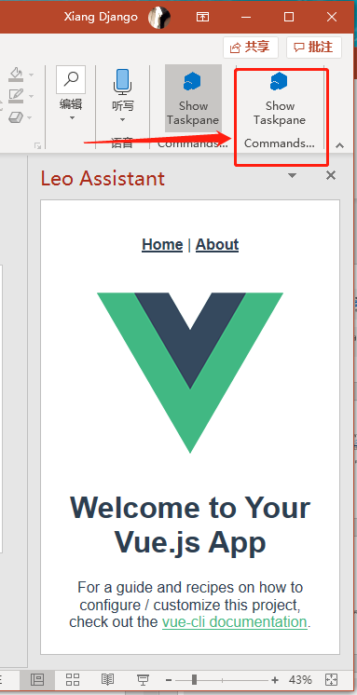
项目启动
先启动项目本体：npm run serve
确保访问 https://localhost:3000/ 可以正常打开（但是没有任何内容）
再启动Office插件项目：npm run start
如果设置的正确，那么会在PowerPoint的开始工具栏上出现一个按钮，点击之后打开的是VUE的默认界面。这表示开发所必须的基本环境已经设置成功。

Slide 7
Office 文档的内容格式 Coercion Type
Html | Return or set data as HTML.
 | Note: Only applies to data in add-ins for Word and Outlook add-ins for Outlook (compose mode).
Image | Data is returned or set as an image stream. Note: Only applies to data in Excel, Word, and PowerPoint.
Matrix | Return or set data as tabular data with no headers. Data is returned or set as an array of arrays containing one-dimensional runs of characters. For example, three rows of string values in two columns would be: [["R1C1", "R1C2"], ["R2C1", "R2C2"], ["R3C1", "R3C2"]].
 | Note: Only applies to data in Excel and Word.
Ooxml | Return or set data as Office Open XML.
 | Note: Only applies to data in Word.
SlideRange | Return a JSON object that contains an array of the ids, titles, and indexes of the selected slides. For example, {"slides":[{"id":257,"title":"Slide 2","index":2},{"id":256,"title":"Slide 1","index":1}]} for a selection of two slides.
 | Note: Only applies to data in PowerPoint when calling the Document.getSelectedData method to get the current slide or selected range of slides.
Table | Return or set data as tabular data with optional headers. Data is returned or set as an array of arrays with optional headers.
 | Note: Only applies to data in Excel and Word.
Text | Return or set data as text (string). Data is returned or set as a one-dimensional run of characters.
XmlSvg | Data is returned or set as XML data containing an SVG image. Note: Only applies to data in Excel, Word, and PowerPoint.

Slide 8
Office 文档的内容格式支持类型
Host | Supported coercionType
Excel, PowerPoint, Project, and Word | `Office.CoercionType.Text` (string)
Excel and Word | `Office.CoercionType.Matrix` (array of arrays)
Excel and Word | `Office.CoercionType.Table` (TableData object)
Word | `Office.CoercionType.Html`
Word | `Office.CoercionType.Ooxml` (Office Open XML)
PowerPoint on the web and Windows | `Office.CoercionType.SlideRange`
Excel, PowerPoint, and Word | `Office.CoercionType.XmlSvg`

Slide 9
读取内容（仅PowerPoint）
window.Office.context.document.getSelectedDataAsync
参数： (coercionType, options, callback)
coercionType：数据类型（见前文）
返回数据的格式（本项为可选）
valueFormat：是否为被格式化的数据 formatted | unformatted
filterType：是否只需要可见数据 all | onlyVisible
asyncContent：将内容传递给回调函数（回调函数的asyncContext属性）
回调函数
方法本身不返回任何值
https://docs.microsoft.com/en-us/javascript/api/office/office.document?view=word-js-preview#getselecteddataasync-coerciontype--callback-

Slide 10
写入内容
window.Office.context.document.setSelectedDataAsync
参数：data, options, callback
data：要写入的数据，字符串（base64），Office专用TableData或其他
options：插入数据的选项
asyncContent：自定义传递数据
cellFormat：单元格格式
coerionType：数据格式
imageHeight,imageLeft,imageTop,imageWidth：图片位置
tableOptions：表格选项键值对
callback：回调函数
https://docs.microsoft.com/en-us/javascript/api/office/office.document?view=word-js-preview#setselecteddataasync-data--options--callback-

Slide 11
坑点
使用 manifest.xml 启动，需要留意启动的平台是什么（Word Execl 还是 PowerPoint）
启动顺序为：先启动网站，再启动 manifest
VUE+Webpack下的热补丁无效，每次修改后还是得刷新页面
所有的资源，必须是SSL（即：https）
苹果安装：需要安装Xcode

